Slide 1


CIT End-of-Year
Review of Records
May 14, 2025
Stefan Cohen, Director, Career in Teaching

Slide 2
Review of What Now?
The Review of Records is an informal dialogue about the process you use to monitor and document your Intern’s progress. It allows time to discuss your recommendations for your Interns, and it is intended to support you in your efforts and to provide important feedback to the CIT Governing Panel about our procedures. This meeting should be a pleasant, satisfying way to close out your mentoring year.
Look for an email invitation to schedule your meeting
with your Panel Contact very soon
(time slots before and after school throughout the month of June)!

Slide 3
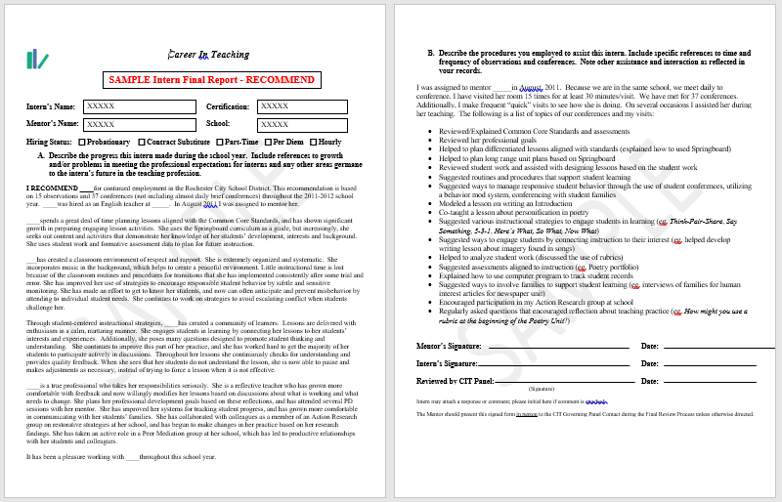
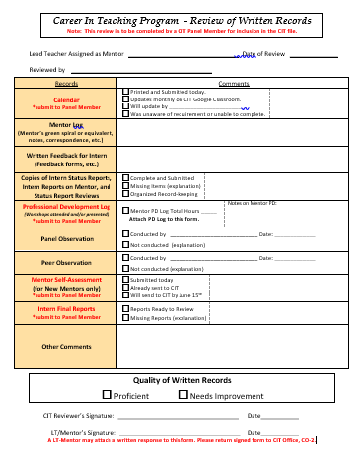
Two Parts of Review of Records
Review of Intern Final Reports
Review of Mentor Records
Not for professional support or “off-cycle” Interns that will continue into next school year. We will still discuss the teachers you are supporting, even if there is not an Intern Final Report.

Slide 4
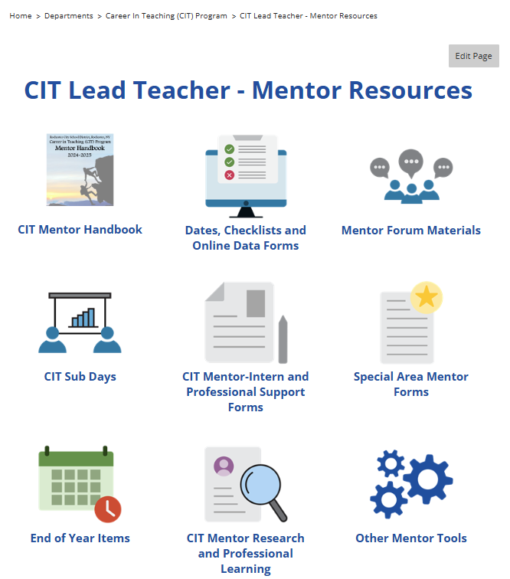
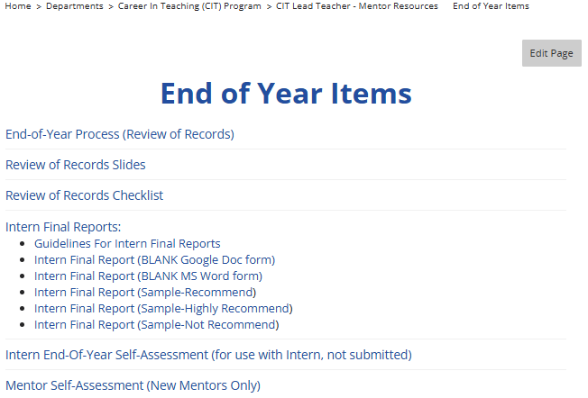
Use Your Tools – www.rcsdk12.org/CIT/Resources

Slide 5
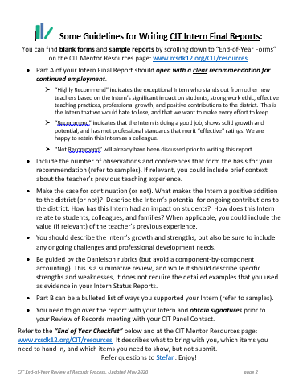
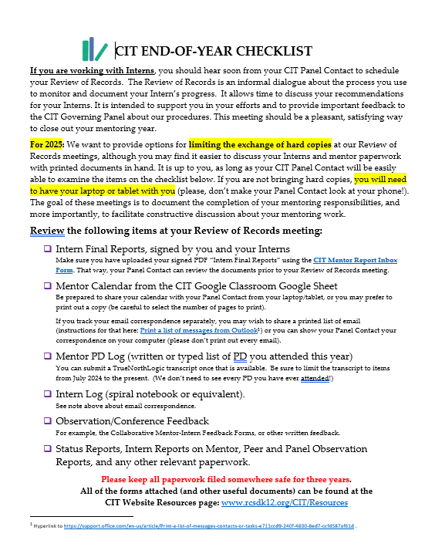
Use Your Tools – www.rcsdk12.org/CIT/Resources

Slide 6
Some Guidelines for
Writing CIT Intern Final Reports
Part A of your Intern Final Report should open with a clear recommendation for continued employment.
“Highly Recommend” | “Recommend”
indicates the exceptional Intern who stands out from other new teachers based on the Intern’s significant impact on students, strong work ethic, effective teaching practices, professional growth, and positive contributions to the district. This is the Intern that we would hate to lose, and that we want to make every effort to keep. | indicates that the Intern is doing a good job, shows solid growth and potential, and has met professional standards that merit “effective” ratings. We are happy to retain this Intern as a colleague.

Slide 7
Some Guidelines for
Writing CIT Intern Final Reports
Part A of your Intern Final Report should open with a clear recommendation for continued employment.
Include the number of observations and conferences that form the basis for your recommendation (refer to samples). If relevant, you could include brief context about the teacher’s previous teaching experience.
Make the case for continuation (or not). What makes the Intern a positive addition to the district (or not)? Describe the Intern’s potential for ongoing contributions to the district. How has this Intern had an impact on students? How does this Intern relate to students, colleagues, and families? When applicable, you could include the value (if relevant) of the teacher’s previous experience.
You should describe the Intern’s growth and strengths but also be sure to include any ongoing challenges and professional development needs, including recommendations for Professional Support.
Be guided by the Danielson rubrics (but avoid a component-by-component accounting). This is a summative review, and while it should describe specific strengths and weaknesses, it does not require the detailed examples that you used as evidence in your Intern Status Reports.
Part B can be a bullet list of ways you supported your Intern (refer to samples).
You need to go over the report with your Intern and obtain signatures prior to your Review of Records meeting with your CIT Panel Contact.

Slide 9
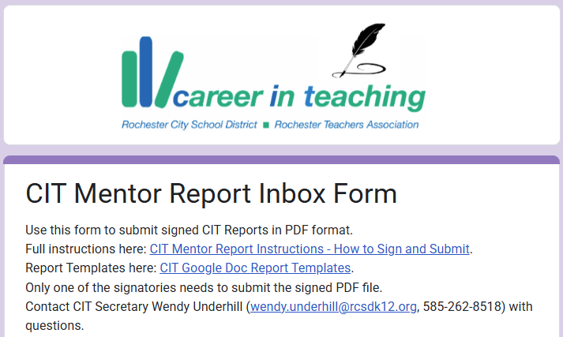
What’s New…CIT Mentor Report Inbox Form

Slide 10
Your Panel Contact will . . .
ask clarifying questions to help you summarize your experiences with Intern(s) and to support your recommendation about the Intern’s continued employment
Some helpful guiding questions might include:
  What is the Mentor’s overall recommendation and what are the main reasons for that recommendation?
  What are some ways that the Intern demonstrated growth in planning/preparation, instruction, learning environment, and/or professional responsibilities/growth?
  How does the school administration perceive the Intern?
  What are the most significant strengths/accomplishments of the Intern?
  What should the professional learning focus of the Intern going forward?

Slide 11
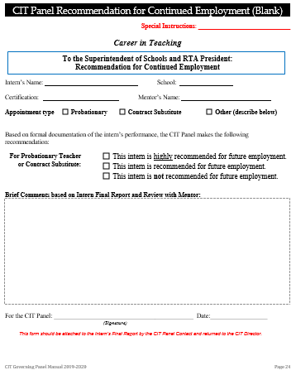
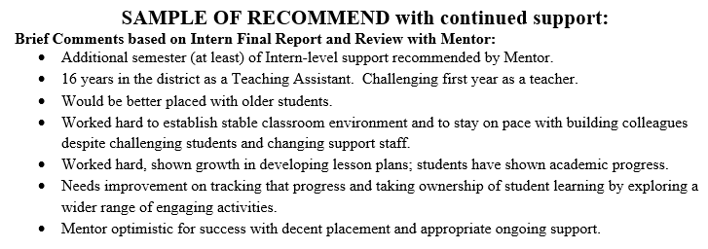
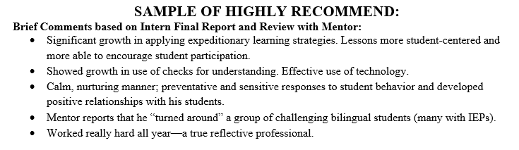
Panel Recommendation “Cover Sheet”

Slide 12
Review at your Review-of-Records Meeting
(bring your laptop or tablet)
Intern Final Reports, signed by you and your Interns
Make sure you have uploaded your signed PDF “Intern Final Reports” using the CIT Mentor Report Inbox Form. That way, your Panel Contact can review the documents prior to your Review of Records meeting.
  Mentor Calendar from the CIT Google Classroom Google Sheet
  Be prepared to share your calendar with your Panel Contact from your laptop/tablet, or you may prefer to print out a copy (be careful to select the number of pages to print).
  If you track your email correspondence separately, you may wish to share a printed list of email (instructions for that here: Print a list of messages from Outlook) or you can show your Panel Contact your correspondence on your computer (please don’t print out every email).
Mentor PD Log (written or typed list of PD you attended this year)
You can submit a TrueNorthLogic transcript once that is available using the CIT Mentor Report Inbox Form. Be sure to limit the transcript to items from July 2024 to the present. (We don’t need to see every PD you have ever attended!)

Slide 13
Review at your Review-of-Records Meeting
(bring your laptop or tablet)
Intern Log (spiral notebook or equivalent).
See note above about email correspondence.
  Observation/Conference Feedback
  For example, the Collaborative Mentor-Intern Feedback Forms, or other written feedback.
Status Reports, Intern Reports on Mentor, Peer and Panel Observation Reports, and any other relevant paperwork.

Slide 14

CIT Panel
Review or Records Form

